Slide 1
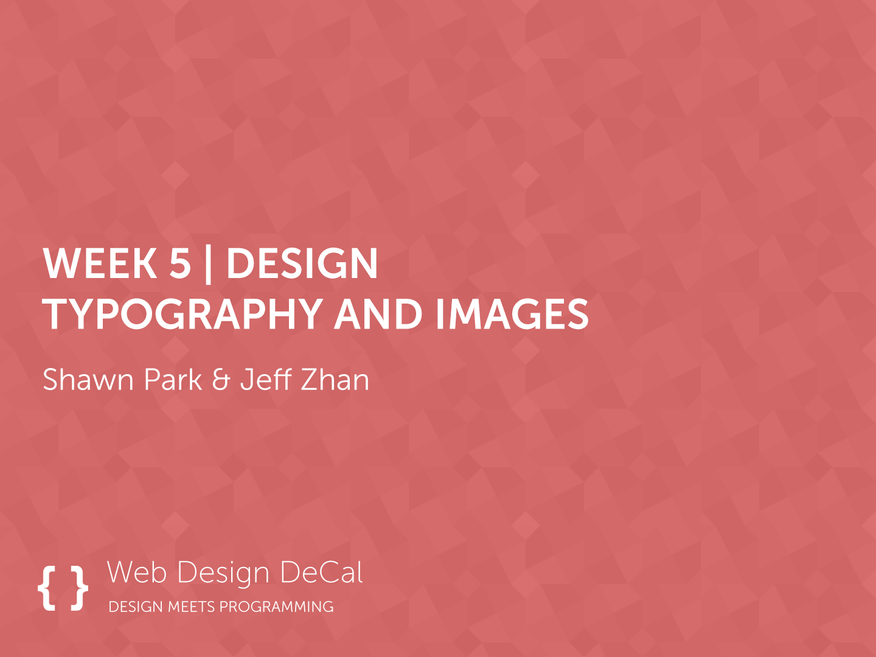

Slide 2
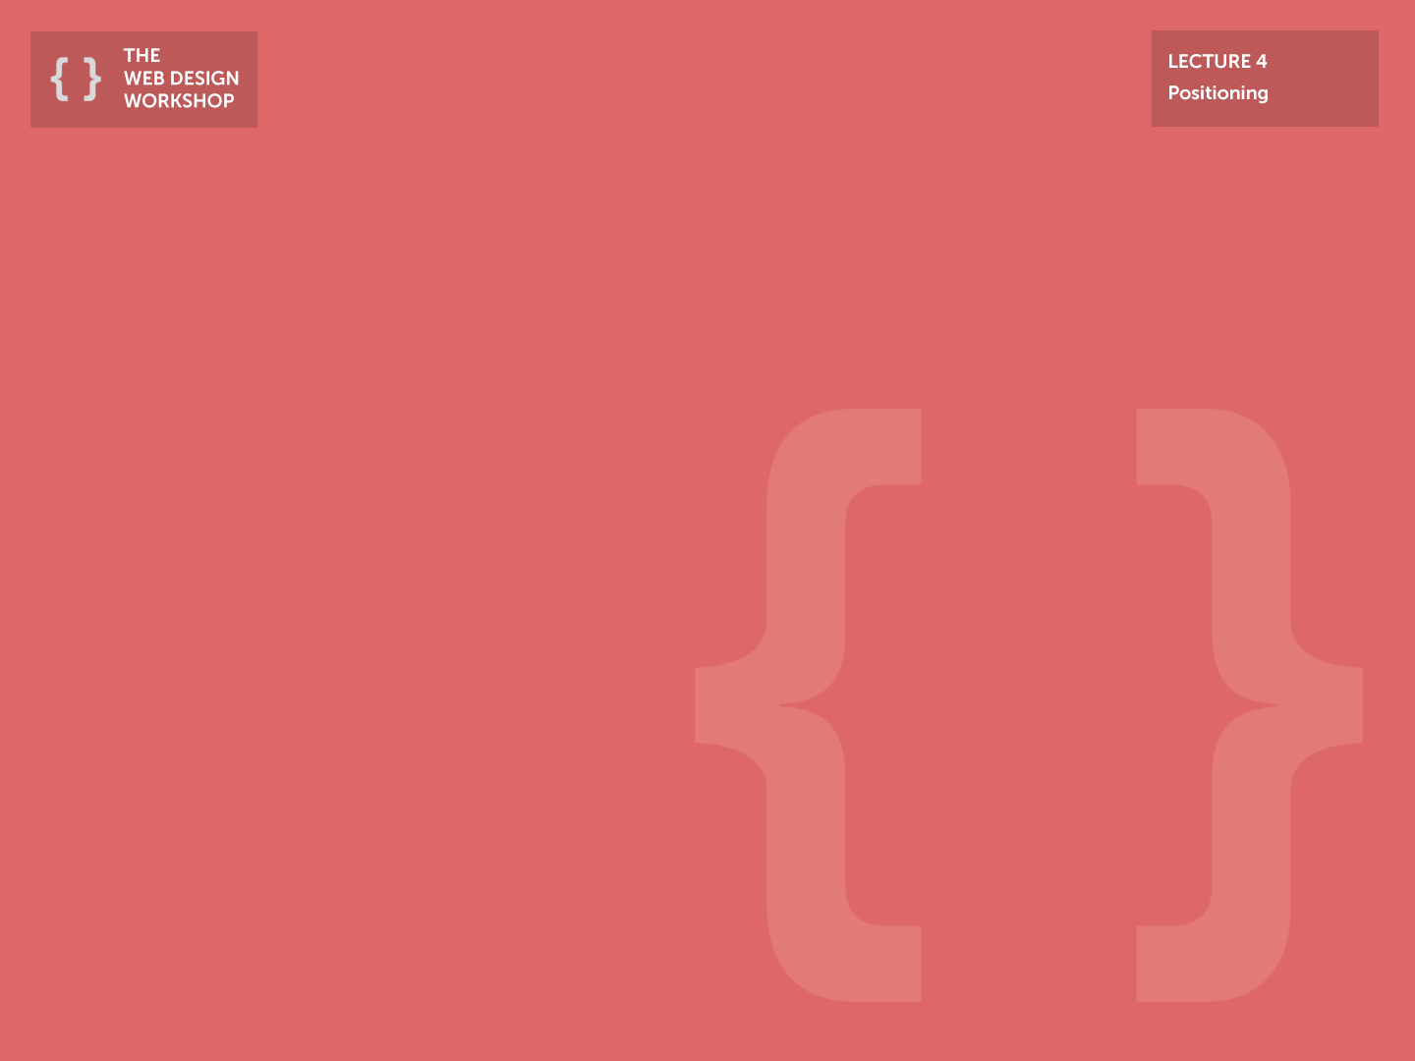
Previous Class
F-style Layout: Place the most important element is top-left -> bottom-right order
General Layout Design: Start from general to specific
Navigation => Contentarea => Content
Divide and conquer: Think about your website as a sum of individual components as you turn it into a code
Single Visual Design: excellent way to provoke emotion for your landing page

Slide 3
Today
What gives websites an emotional appeal?
Typography & Images
Typography
Font-family, Font-size, Font-weight
Choosing the right font
Web Fonts
Images
Image sizing
Thumbnails
Icons
Background

Slide 4
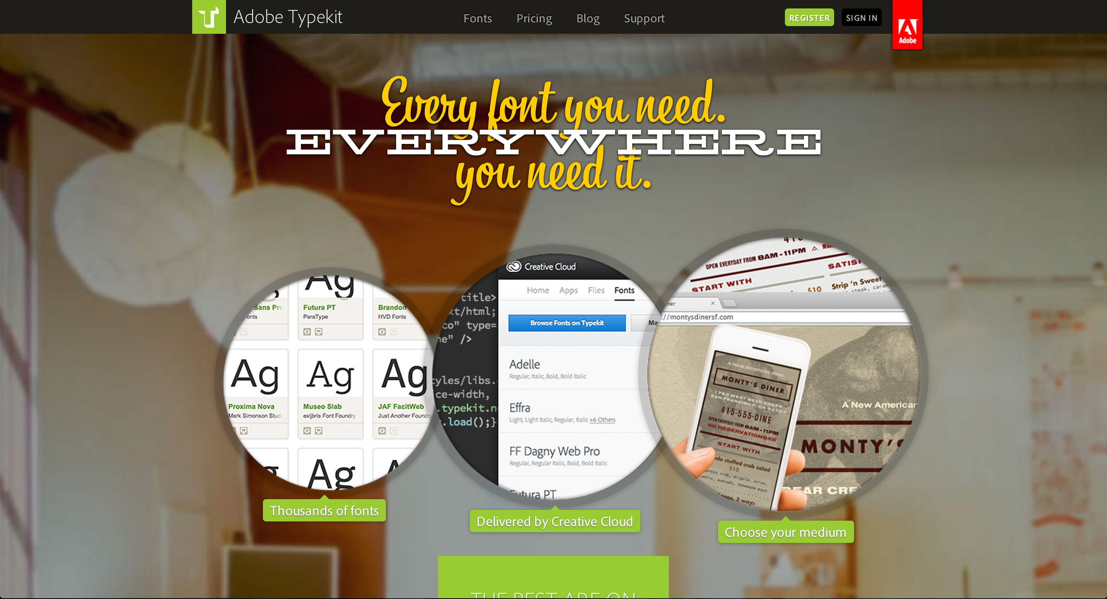
Come on Adobe…

Slide 5
Typography
Serves two main purpose
Heading
Content
The purpose of a web page is to convey information – often more than 80% of the information is expressed as pure “text”

Slide 6
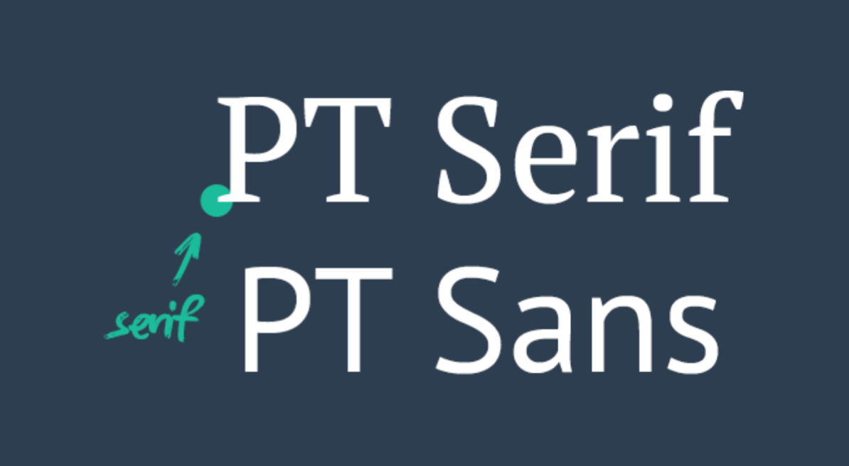
Font-family
Two-types of font:
Serif
Sans-serif
Serif:
Has a little “flick” where the letterforms terminate
Feels “Classy”
Ex.: Times New Roman (Default font without CSS)
Sans-serif:
Does not have a “flick”
Feels “Modern”
Ex.: Helvetica Neue (Default font for iOS and OS X)

Slide 7
Font-family
What should you use?
No, real, definitive answer – different case by case
Generally, choose Sans-serif when building image-heavy websites and choose Serif when building text-heavy websites
Also depends on emotion you want to convey with your website
Modern: Sans-serif
Classy: Serif
Some fonts are optimized for paragraphs; others for headings and graphics

Slide 8
Web Fonts
Fonts are expensive
A set of Helvetica series font costs around $1000.
+ You have to pay extra if you want to serve your font to the public
Alternatives:
Use web fonts – services that allow you to use fonts hosted on other servers
Popular services
Google Font
Typekit

Slide 9
Web Fonts
Google Font
Free, and very easy to install
Sans-serif
Lato, Open Sans, Source Sans, Roboto
Typekit
Requires annual membership ($59) for access to all the fonts
Still way cheaper than paying $1000 for a single set of font
Sans-serif
Freight Sans, Proxima Nova, Museo Sans
Serif
Adelle, Tisa Pro
Notes:
DEMO

Slide 10
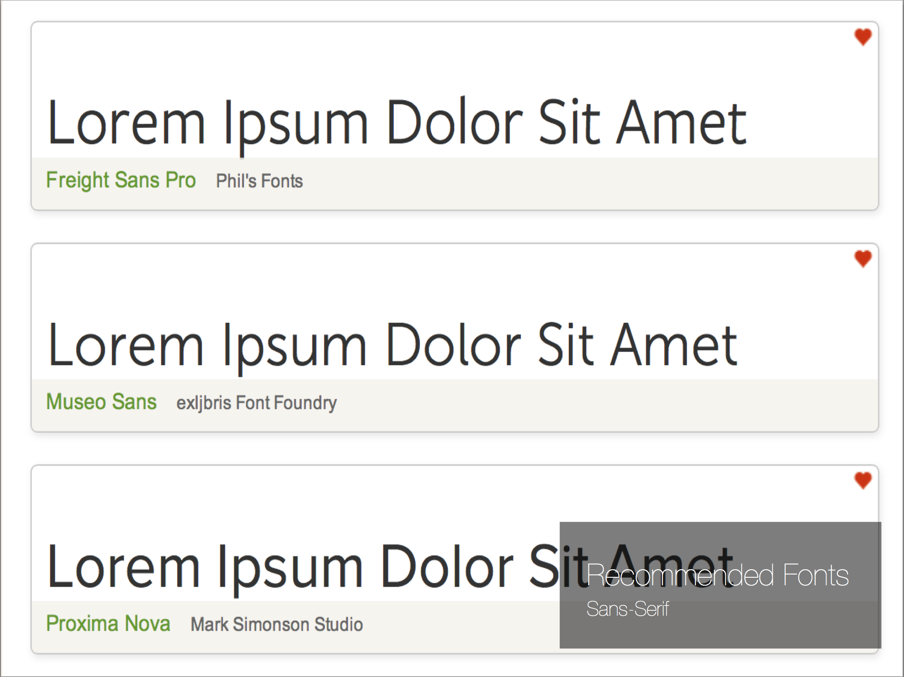

Slide 11
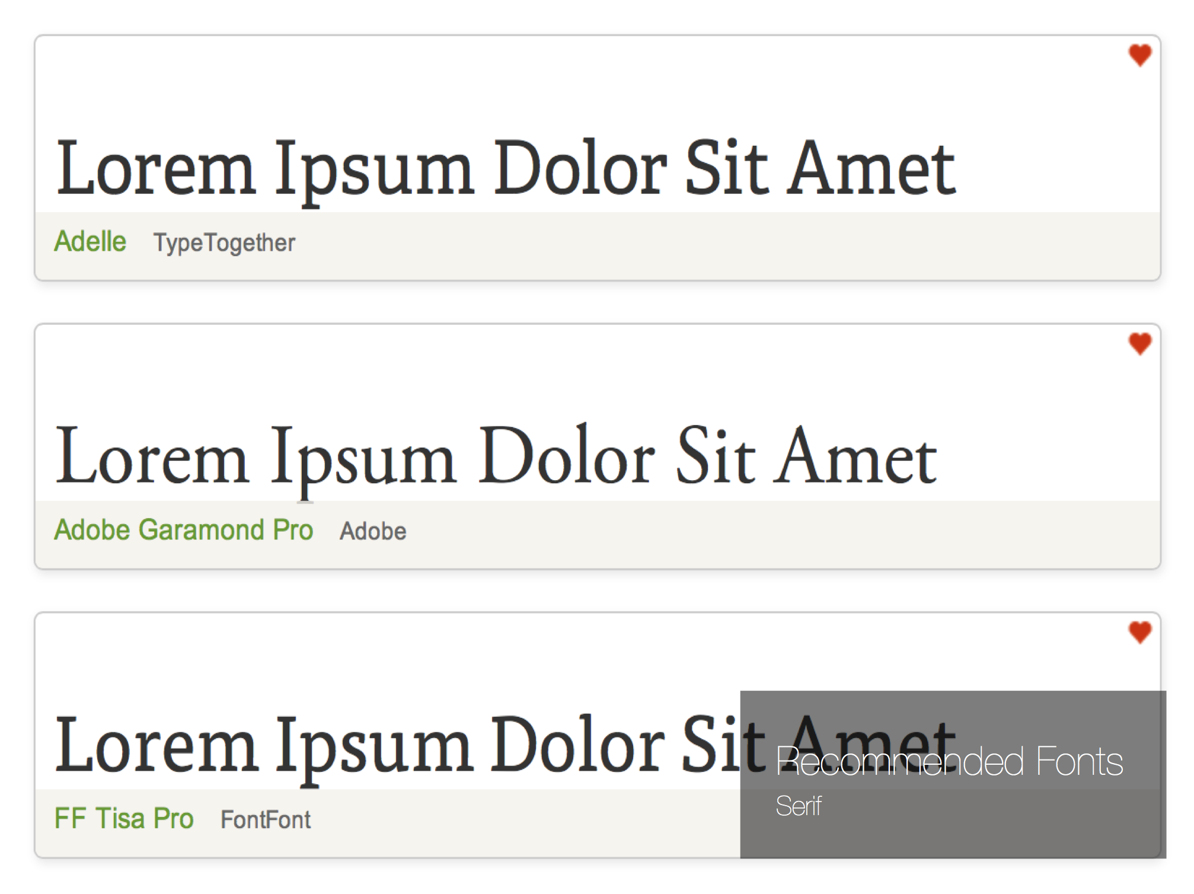

Slide 12
Font-size
Important to have your own “typographic scale” that you use on your web pages
Many people go by order of 6 or 12px
Heading: 36px
Subheading: 24px
Paragraphs: 12px

Slide 13
Thing to consider for Font styles
Target audience
Older audience – larger font-size; Serif; more contrast
Younger audience – smaller font-size; Sans-serif; not as much contrast necessary
Content
Text heavy (Blog) – larger font-size; Serif; Ample spacing
Image / Embellishment heavy – smaller font-size; Sans-serif

Slide 14
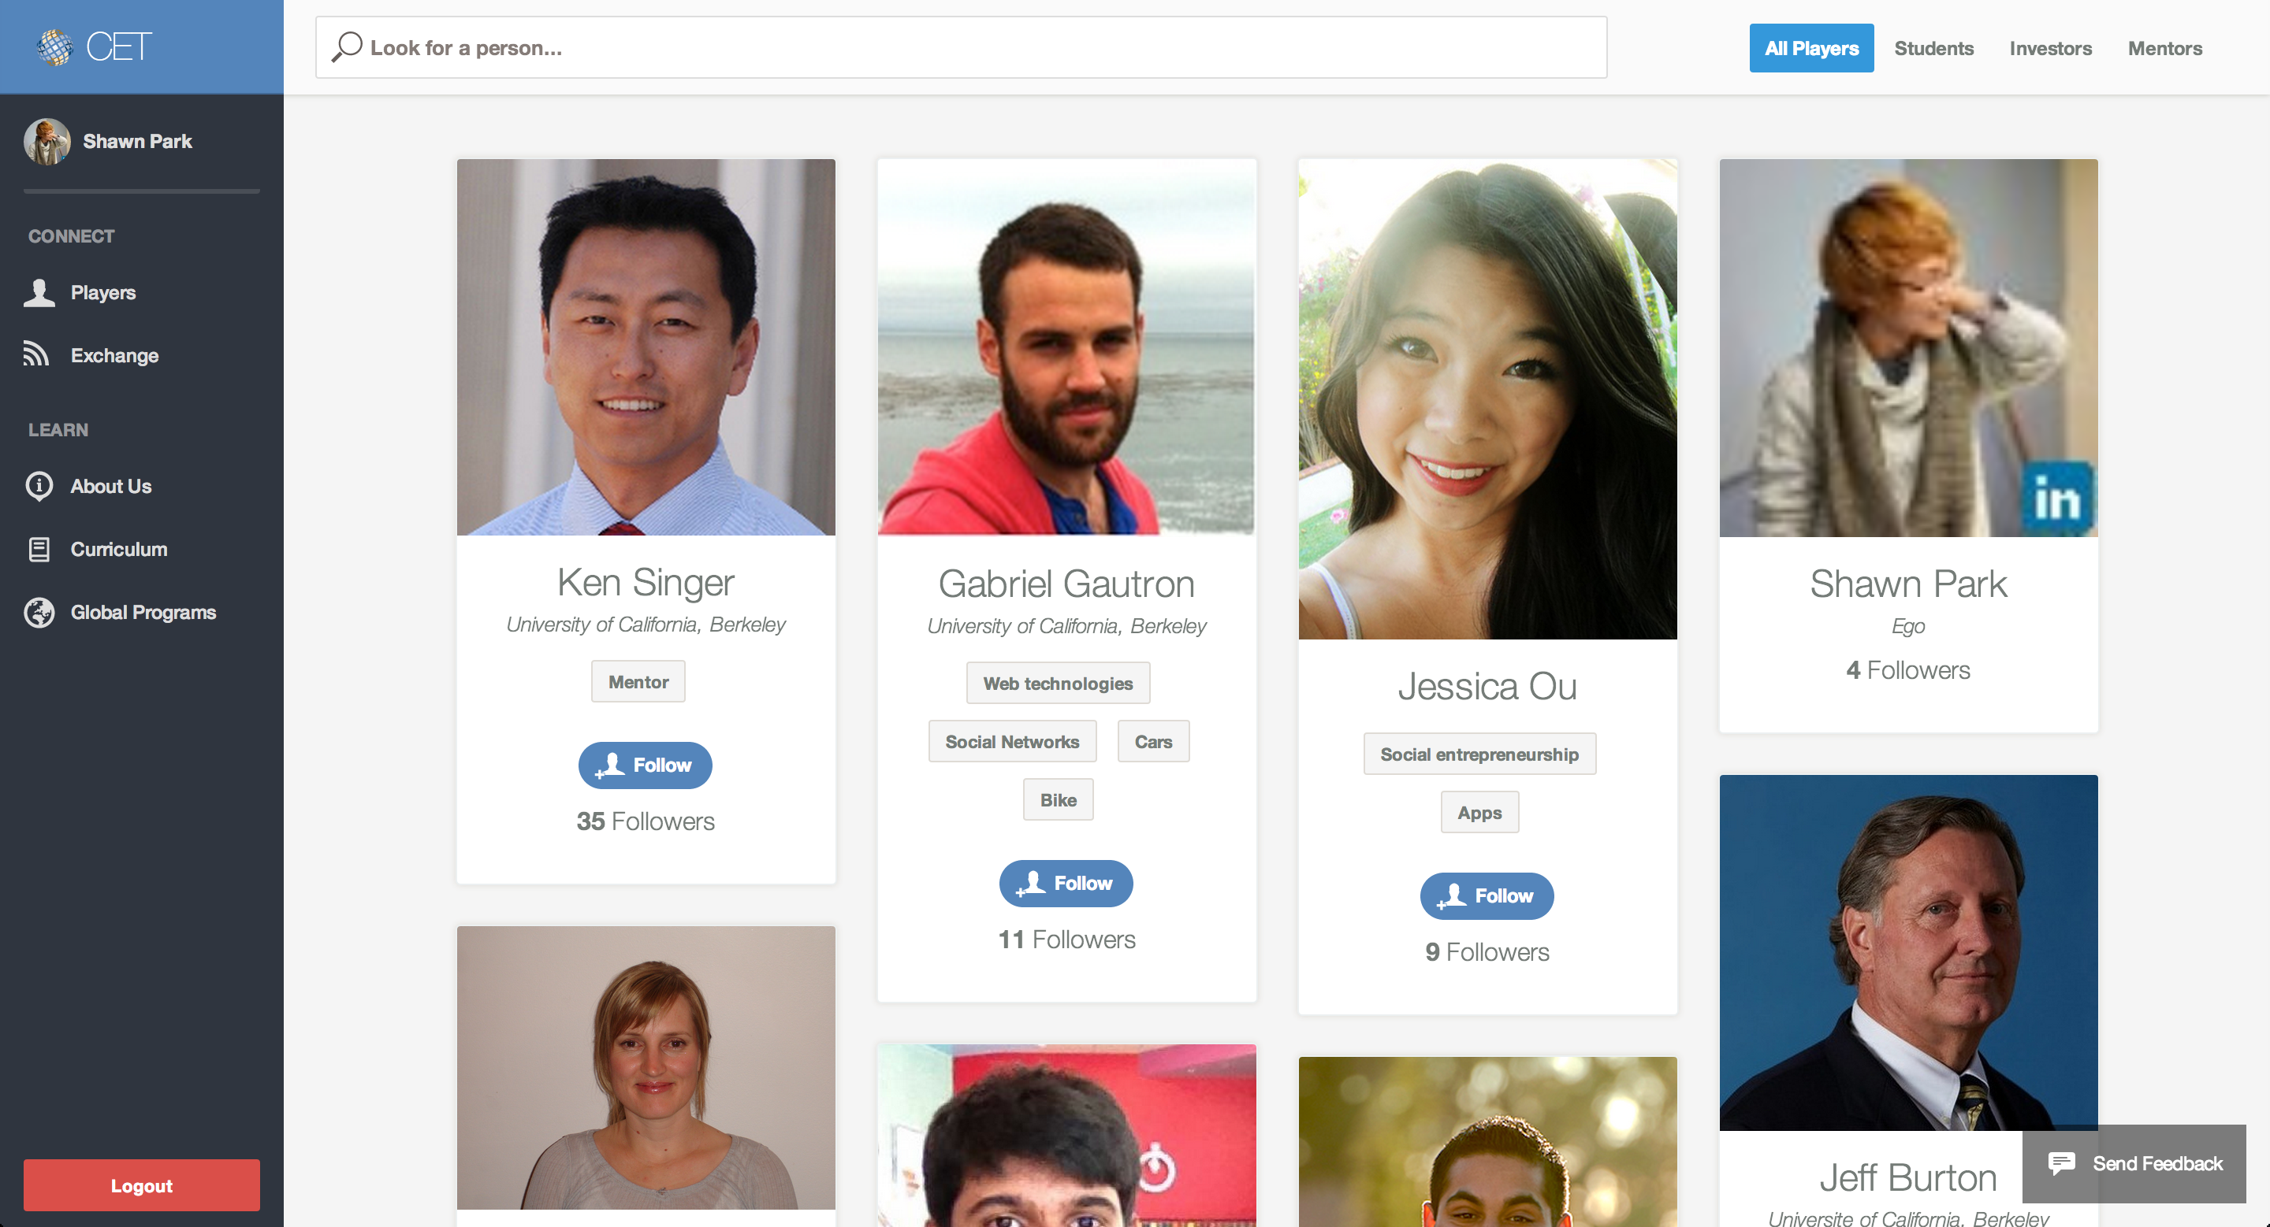
Case Study: CET

Slide 15
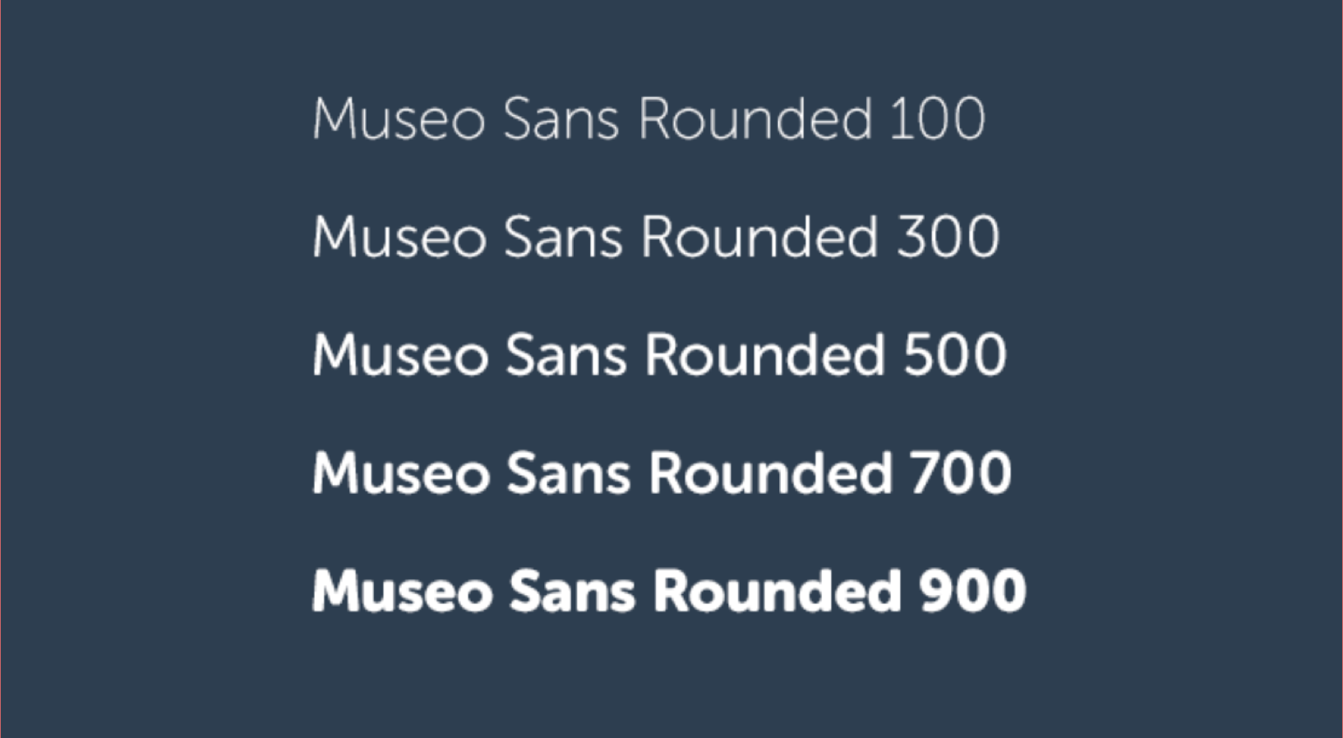
Font-weight
Font-weight determines the “thickness” of the font

Slide 16
Font-weight
Use light-weight fonts carefully!
Bad example of spamming light-weight fonts: iOS 7
Using lighter weight decreases contrast
Where to use light-weight:
Headings
Dark background
Where to use heavy-weight:
Headings
Buttons
Light background

Slide 17
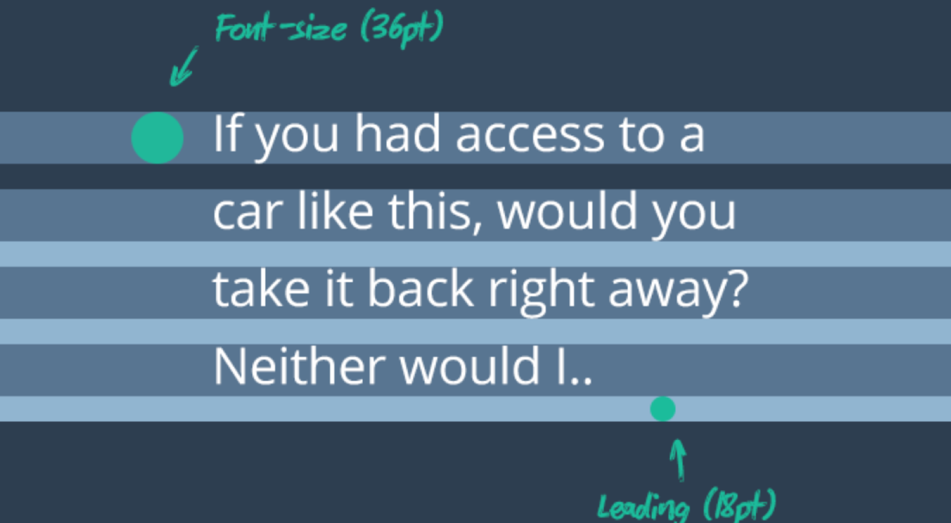
Legibility - Spacing
Add a line-height of around 1.5x the font-size to improve spacing and therefore; the legibility of the paragraph.

Slide 18
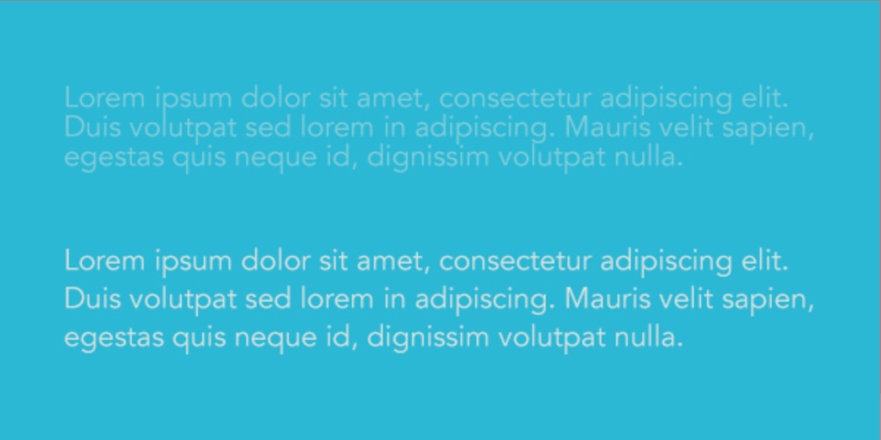
Legibility - Contrast
Use light font on top of dark background and use dark font on top of light background

Slide 19
General choices for Font styles
Headings
Font-size: 24 ~ 48px
Font-weight: Light (300) or Heavy (700)
Paragraphs
Font-size: 12px ~ 16px
Font-weight: Normal (400)
Buttons
Font-size: 11px ~ 13px
Font-weight: Bold (700)

Slide 20
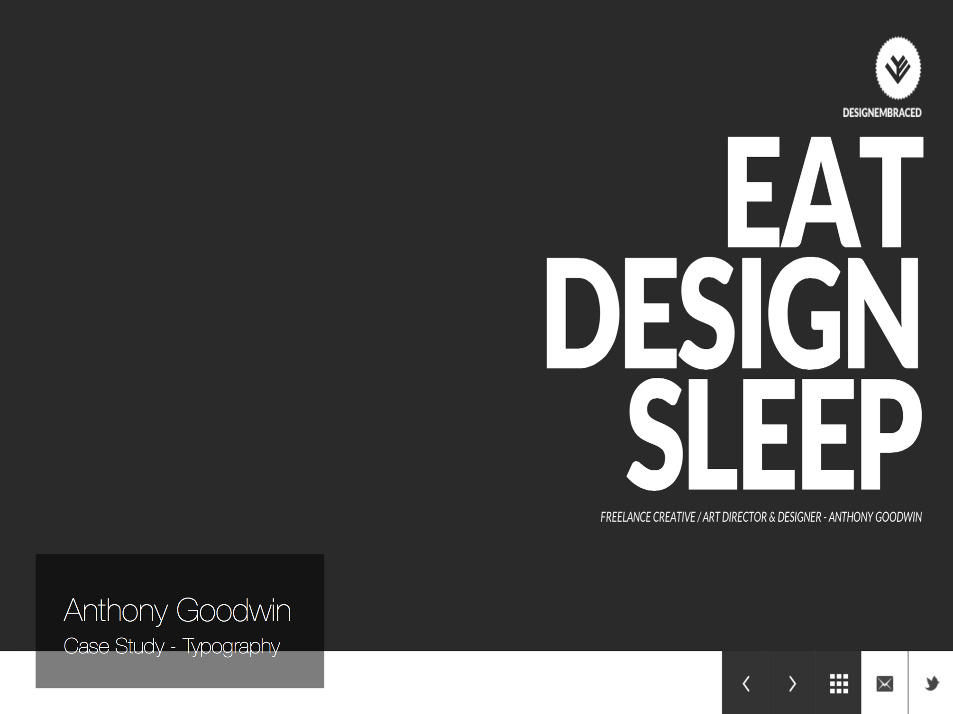

Slide 21
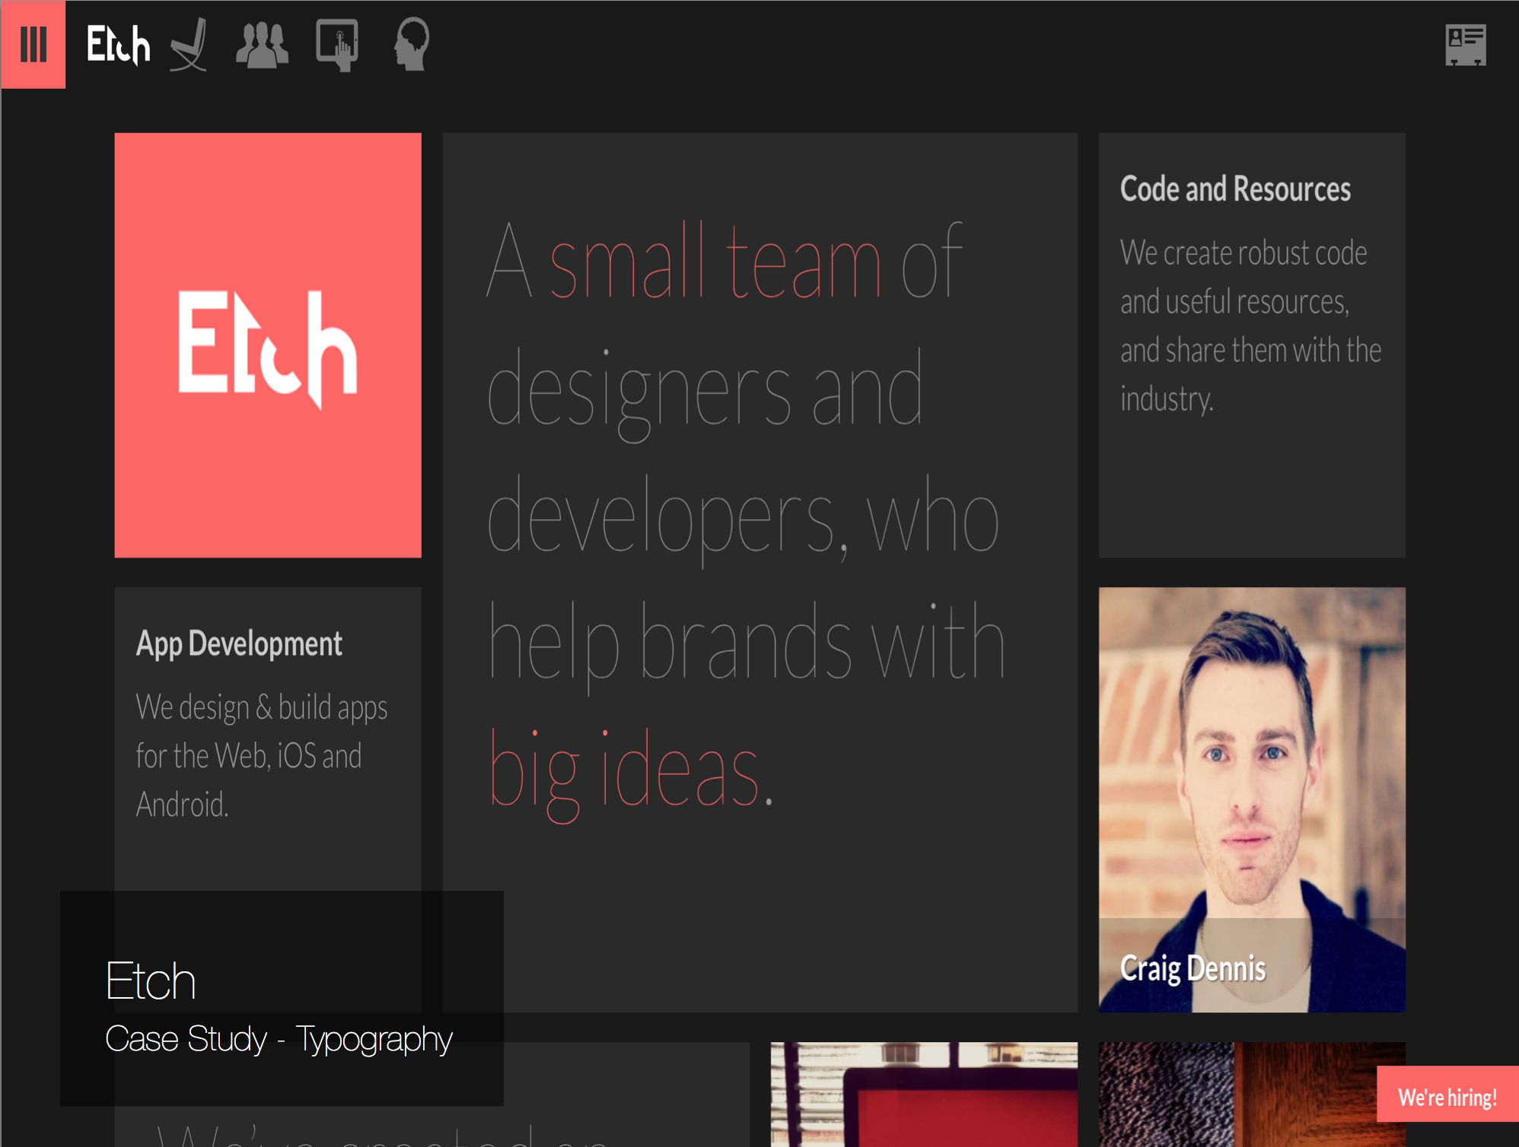

Slide 22
Images
Images can be used as…
Content (Thumbnail images)
Visual guide (Icons)
Emotional appeal (Background)
Important to know when to use images effectively – sometimes images can stylize a website, but other times images can be the easiest way to make your website look amateur.

Slide 23
Image Types
JPEG
Works well for natural image types (Photography)
Prone to damage as you save & edit often
Pretty lightweight compared to PNG
Best For: Large images such as thumbnails & backgrounds
PNG
Supports Transparency
Supports Lossless Compression
Quite heavyweight – especially for PNG24
Best For: Small images such as thumbnails & icons

Slide 24
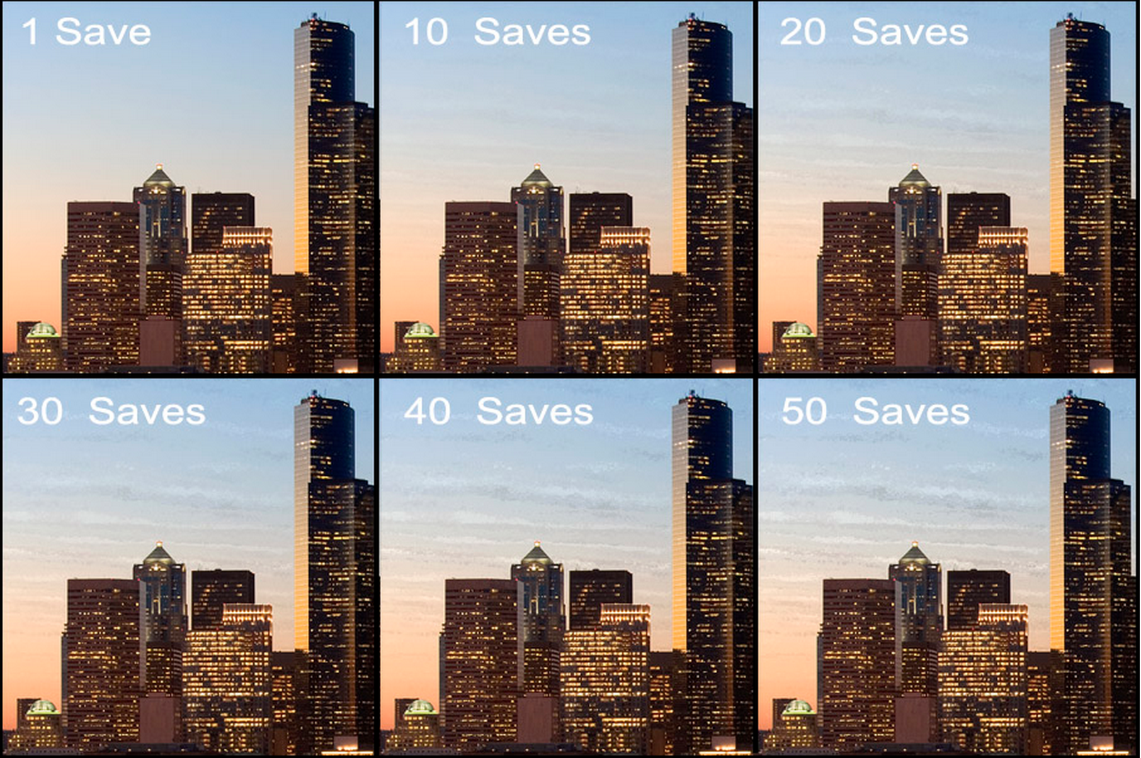
JPEG Deterioration

Slide 25
Image Types
GIF
Supports Animation
Supports only 256 colors
Very Lightweight
Best For: Animated Images and Background Patterns
SVG
Vector Graphics – can be scaled automatically without loss of
quality
Very, very lightweight
Easy to customize on the fly just with a code editor
Hard to use for beginners
Best For: Icons

Slide 26
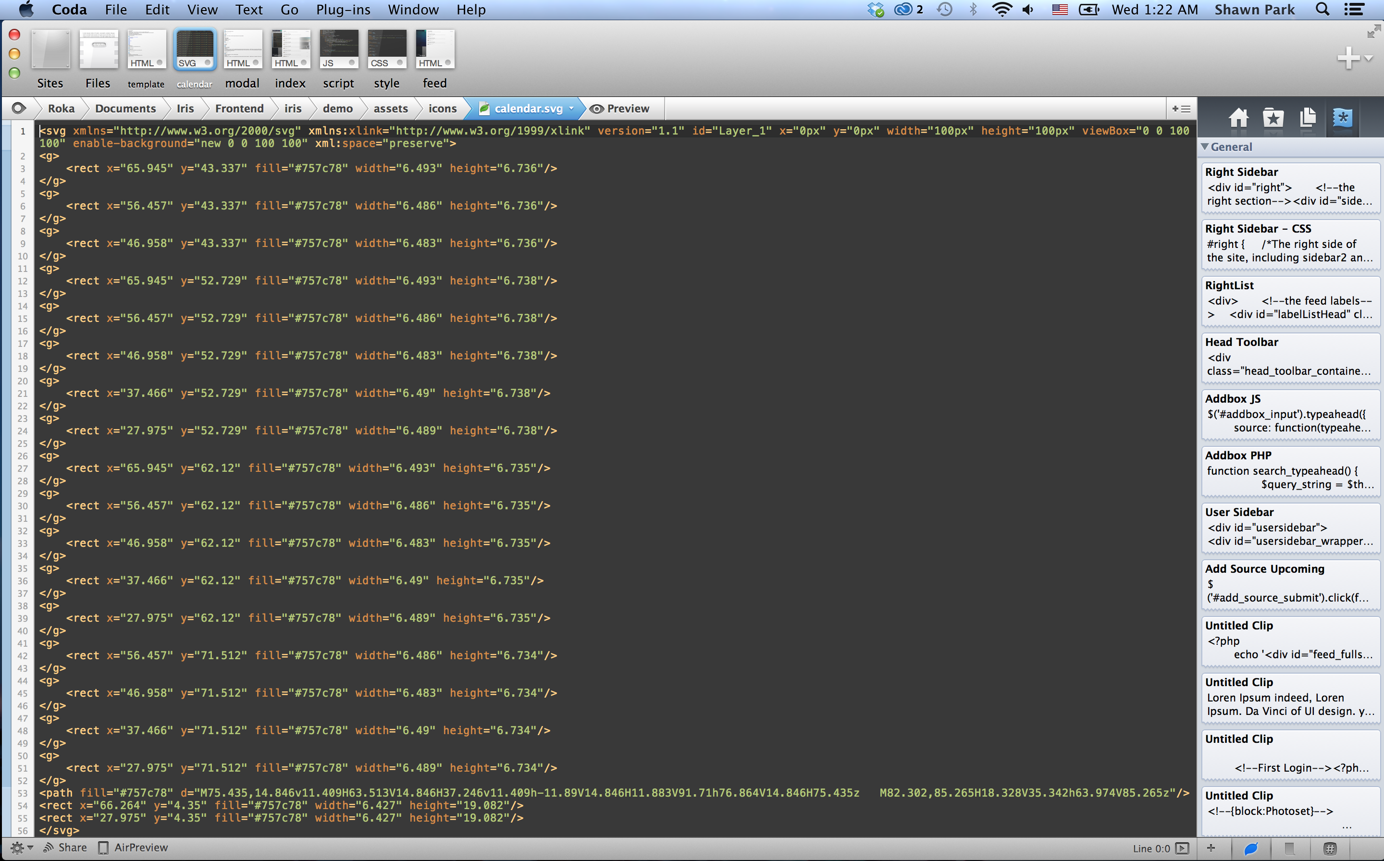
A typical SVG icon

Slide 27
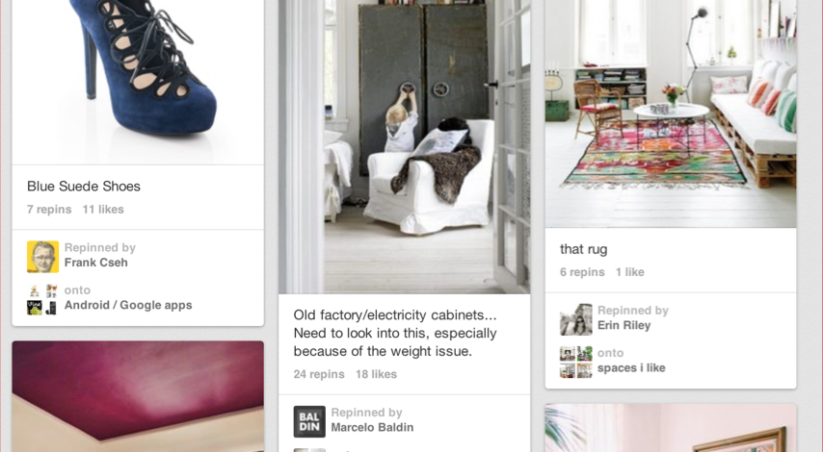
Image Use Case: Thumbnails
Use thumbnails to describe content using an image – usually a set of images
Grid UI and Masonry UI very popular for thumbnails

Slide 28
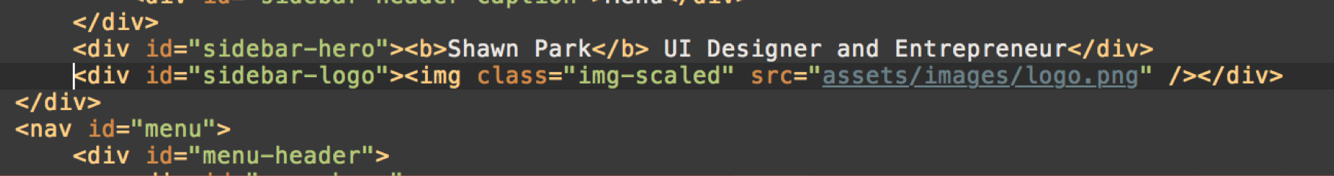
Image Use Case: Thumbnails
You usually try to make an image fit into a box designated by a div
The original image size usually isn’t the same size you would want it to be shown in a web page
Create a box using a div that will hold the image & make the image fit

Slide 29
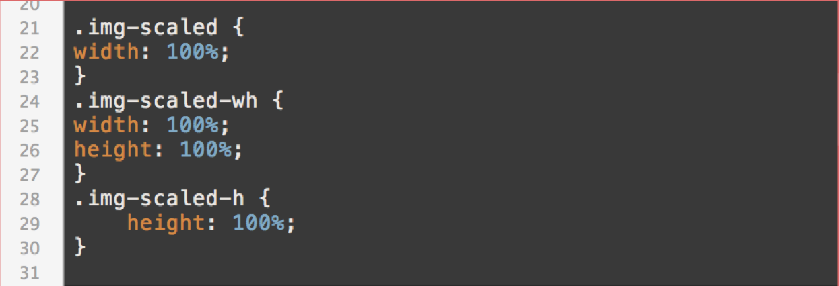
Image Use Case: Thumbnails
TIP: Create a class called “img-scaled” with CSS property “width: 100%;”
This will make the image fit the width of the box
The height of the image will be proportionally scaled depending on the width
Set “width: 100%; height: 100%;” to make an image fit the box without preserving the proportion

Slide 30
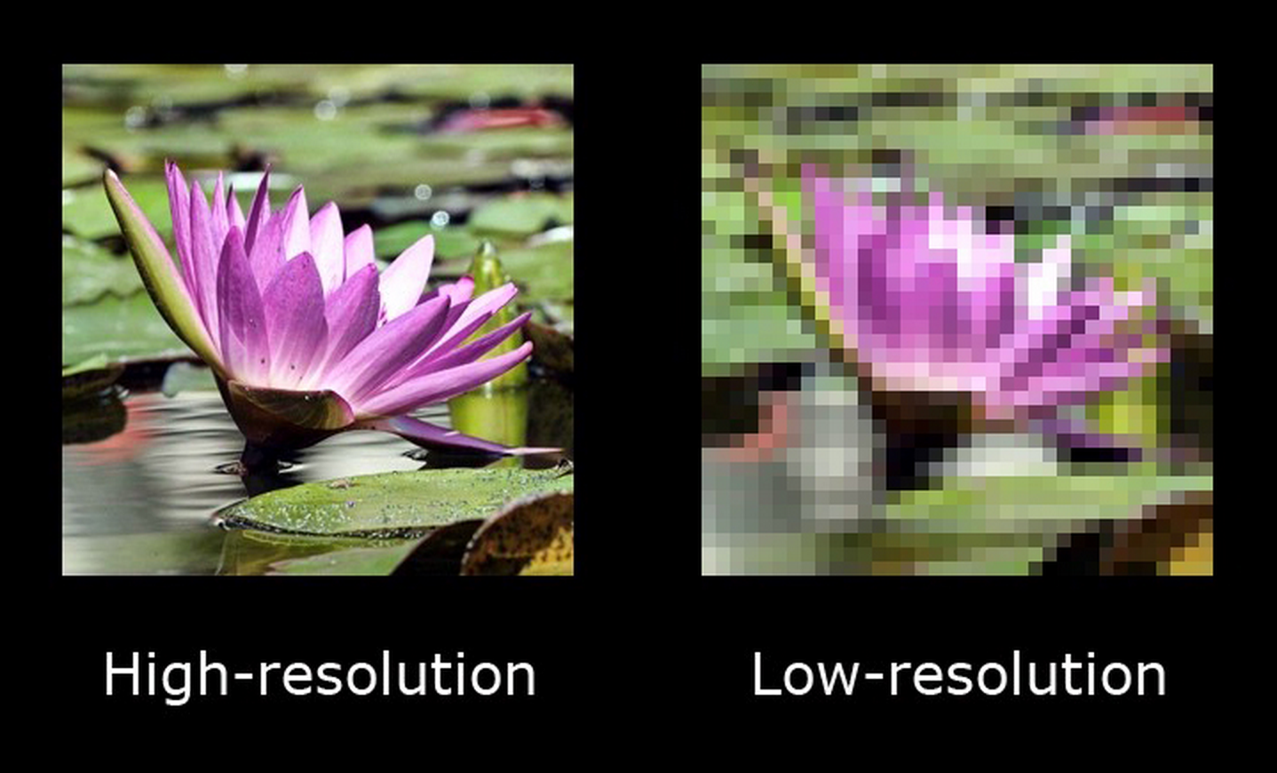
Image Use Case: Thumbnails
Problem: When you have a small image and you try to make it fit, it looks horrendous. (esp. for High-res Display)
Solution: Provide a higher quality image (Better if bigger)
Downside: image size increases

Slide 31
Image Use Case: Thumbnails
Problem: When you try to preserve the proportion of an image, you get unwanted space
Solution 1: Make an image bigger than the box size, and set overflow: hidden (More on this later)
Solution 2: Use Jquery addons like Masonry or Isotope to create a Pinterest style UI.
Notes:
DEMO

Slide 32
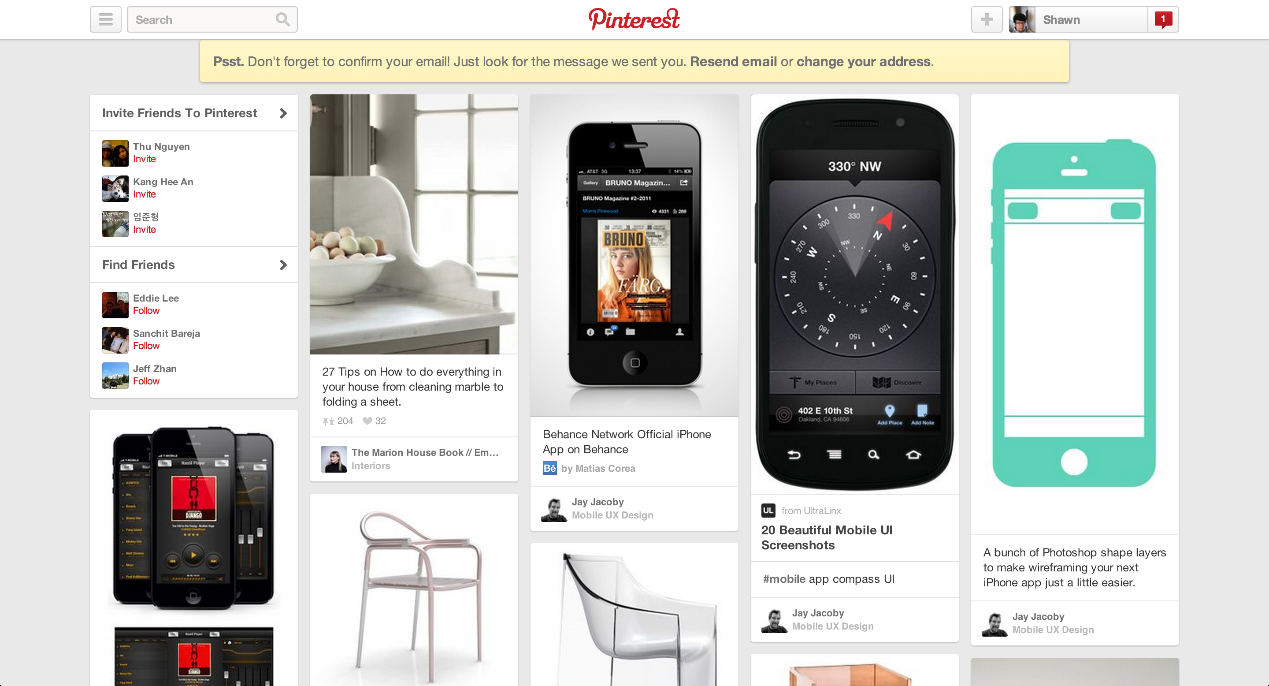
Pinterest-style Masonry UI

Slide 33
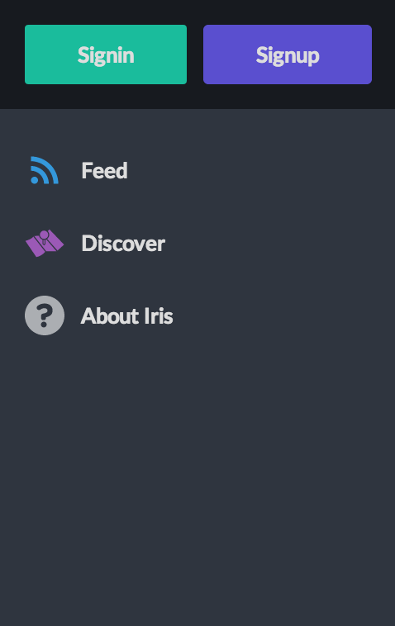
Image Use Case: Icons
Use Icons to provide visual guide to a function (ex. Button)
Usually used side-by-side to a caption
Use similar techniques to thumbnails: Create a div (30x30 or 15x15, etc.) and make an image fit to the box

Slide 34
Image Use Case: Icons
For Flat UI, Icons are usually single, solid color.
White icons go well with other colored background
Black or grey icons go well with white or light grey background
A VERY, VERY USEFUL RESOURCE:
The Noun Project (http://www.thenounproject.com)
Can find virtually any flat icons you need
Icons are in SVG / PNG format – easy to edit if you know how to.

Slide 35
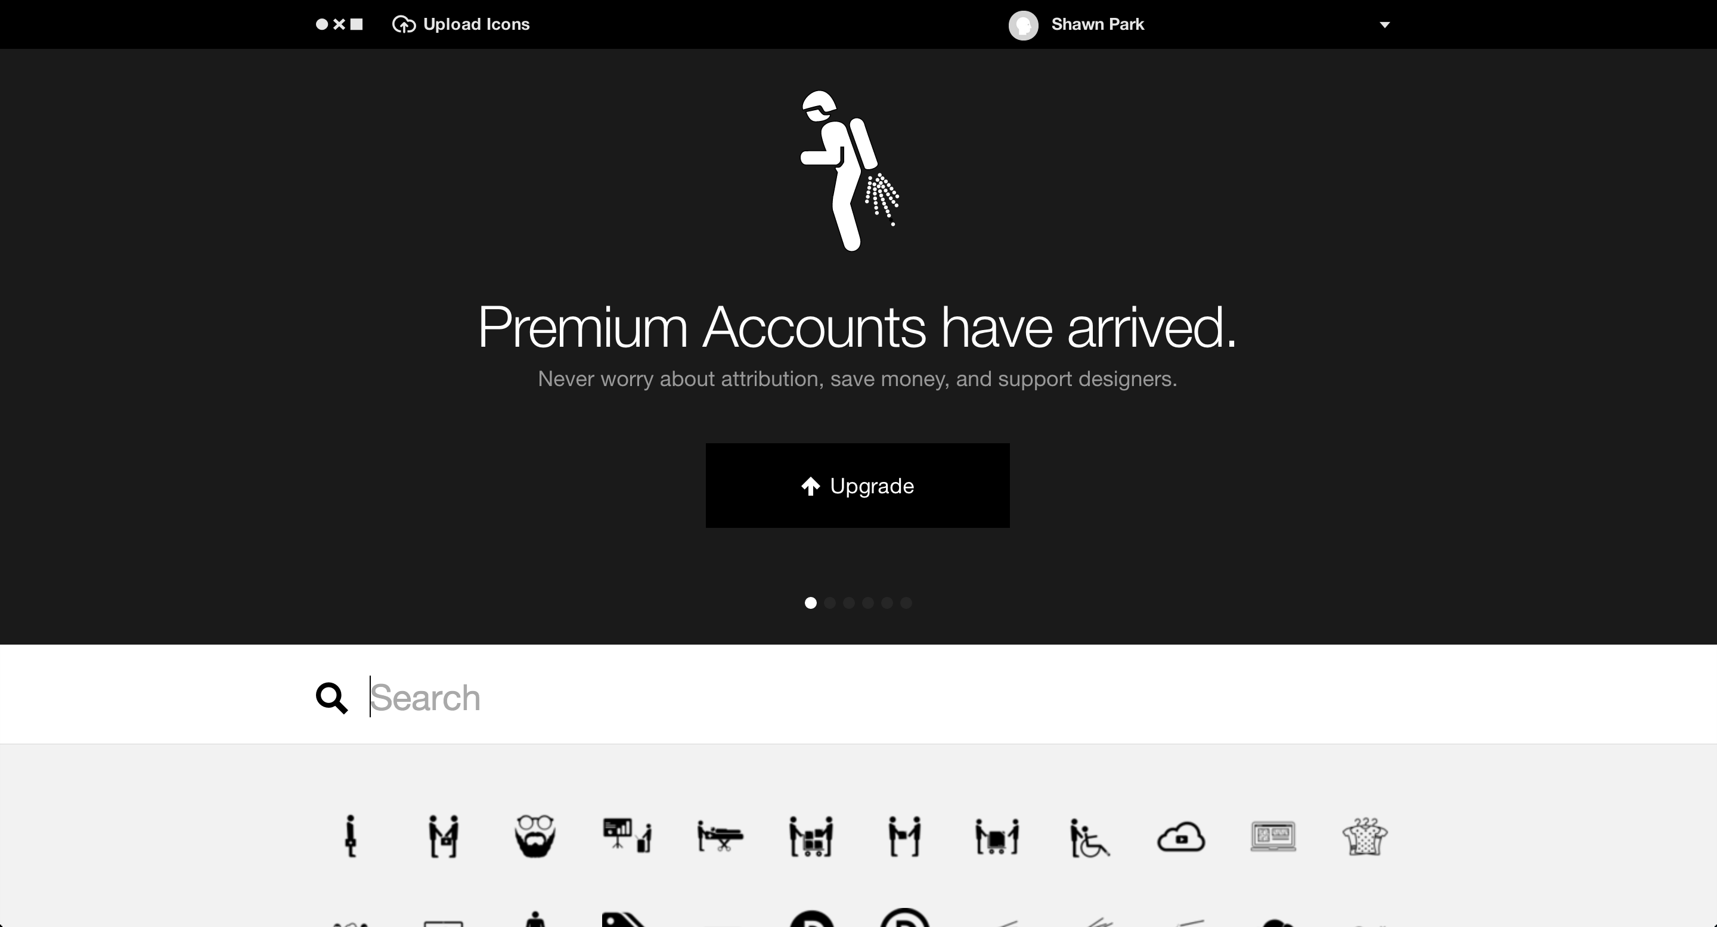
The Noun Project

Slide 36
Image Use Case: Background
Use Background images to create an emotional appeal to the visitor
Two methods:
Fullscreen DIV with position absolute and image tucked inside
Fullscreen DIV with position absolute and CSS background-image property

Slide 37
Image Use Case: Background
Common Mistake: Image obscures the content of website
Usually caused by too light font on top of light background or too dark font on top of dark background
Also caused by text on top of a plain photography image
Makes the eye gravitate toward the image, not the text (content of the website).

Slide 38
Image Use Case: Background
Common Mistake: Image obscures the content of website
Solution 1: Make the image itself darker
Requires some Photoshop work
Adding a blur helps too
Solution 2: Add text-shadow property to the text

Slide 39
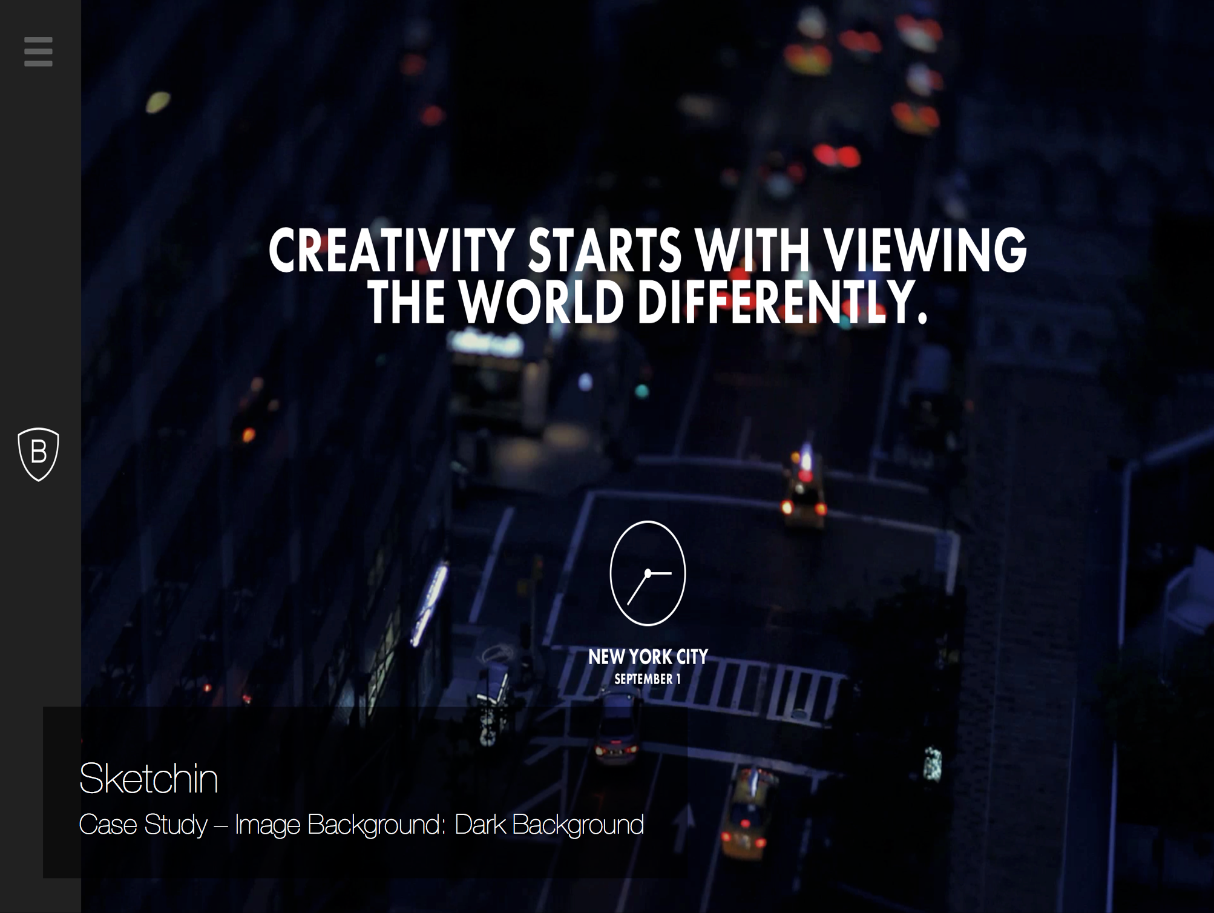

Slide 40
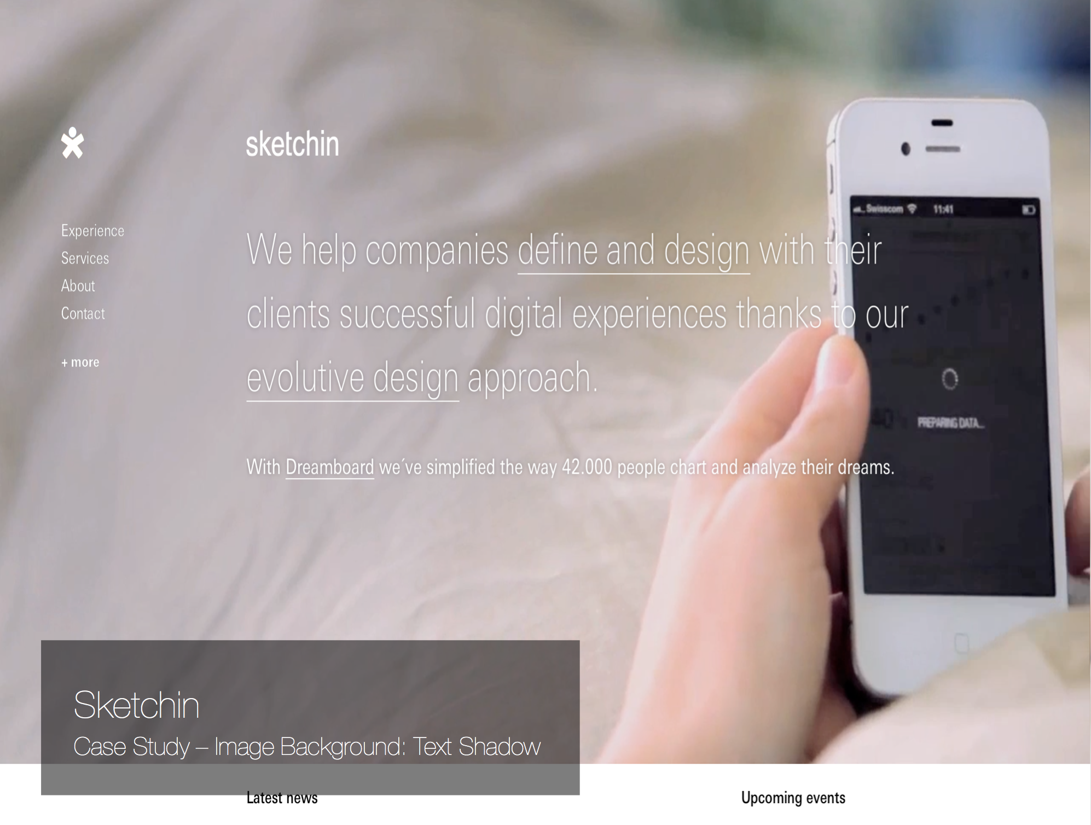

Slide 41
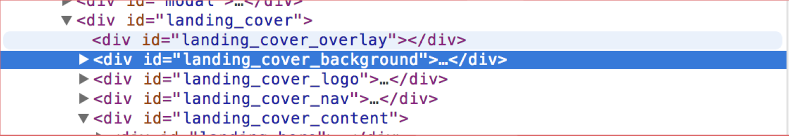
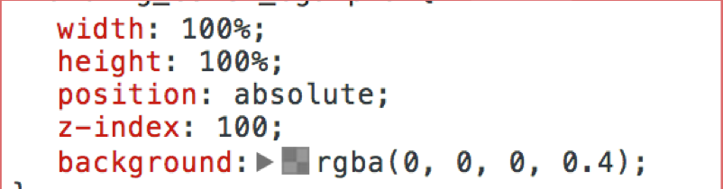
Image Use Case: Background
Common Mistake: Image obscures the content of website
Solution 3: Add a semi-transparent, overlay on top of an image
Notes:
DEMO

Slide 42
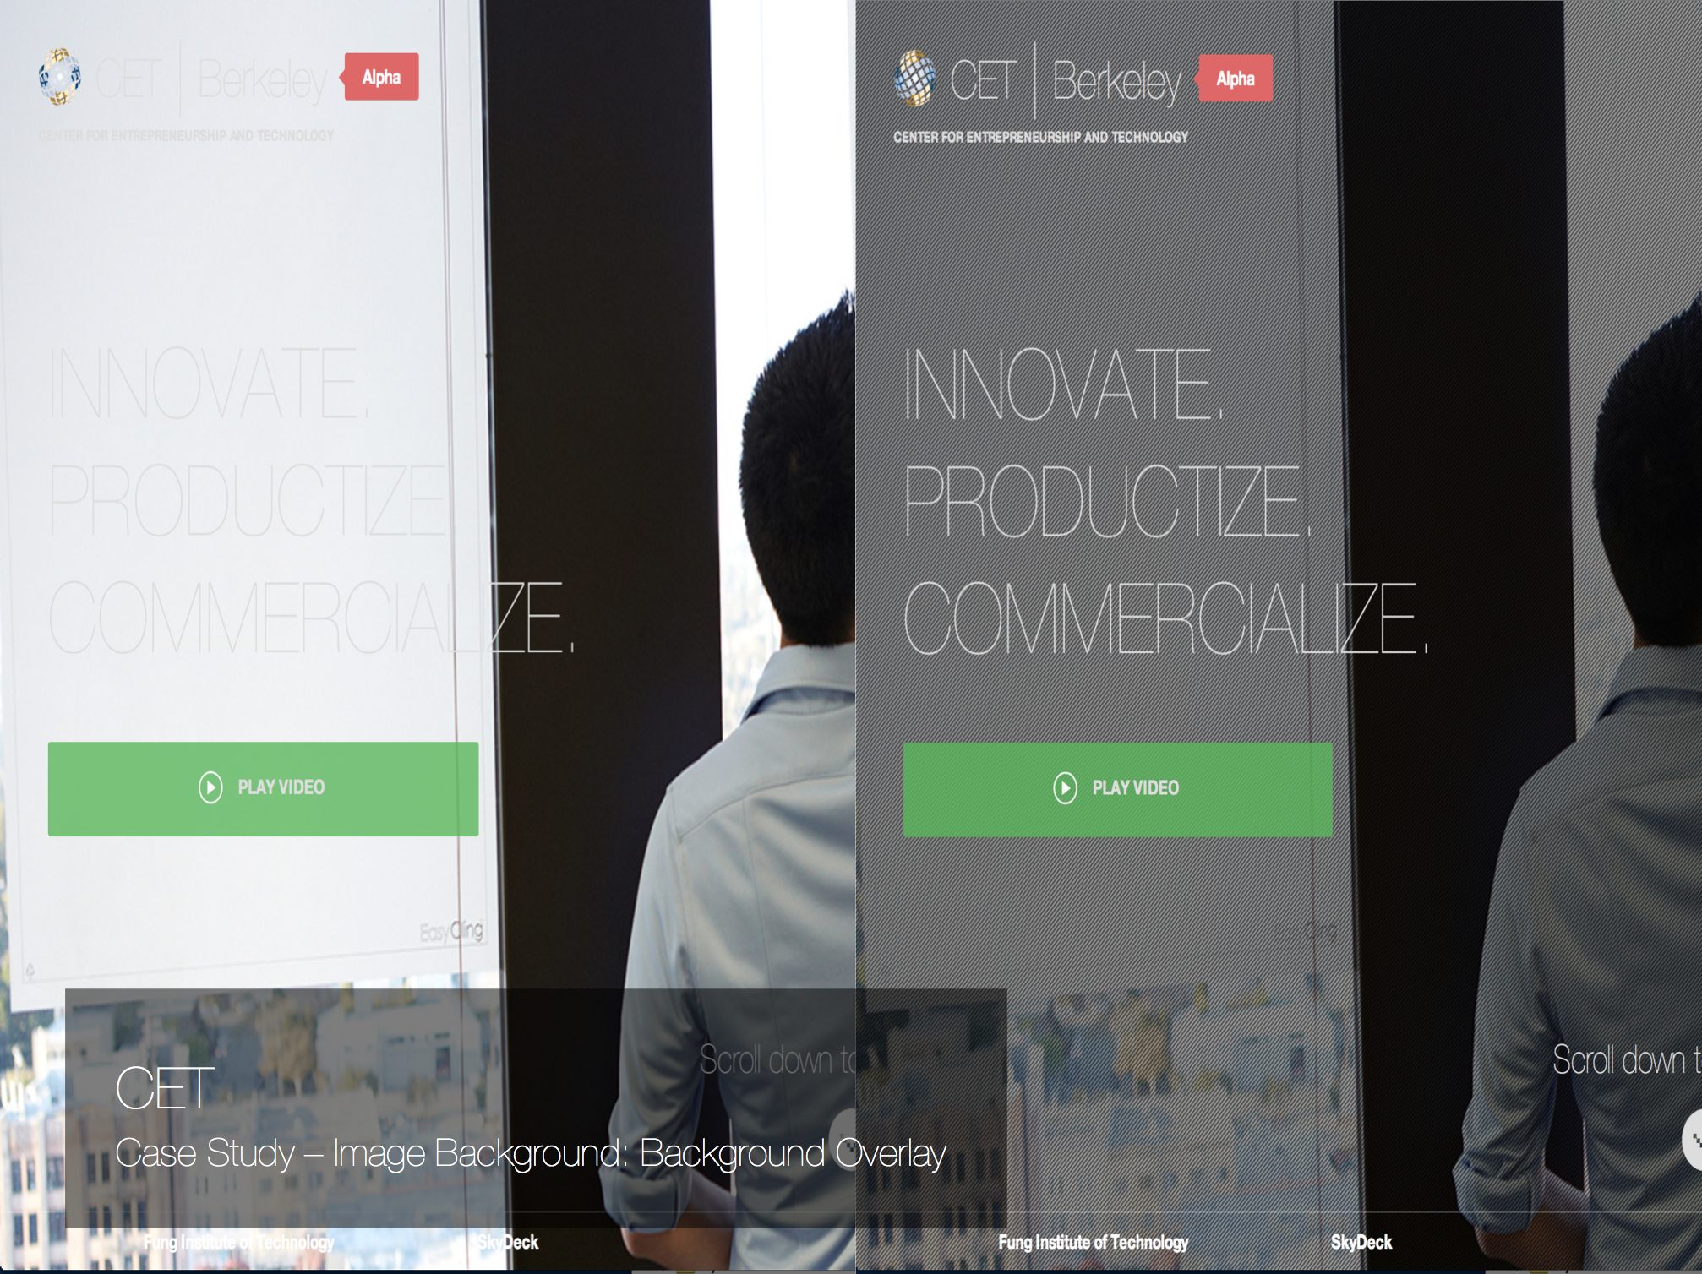

Slide 43
Image Use Case: Background
Trend 1: Video Background
Play a full-screen video background in place of an image background
Can create a really good emotional, dynamic appeal to users
Downside: HTML5 Video tends to be quite taxing on the performance side

Slide 44
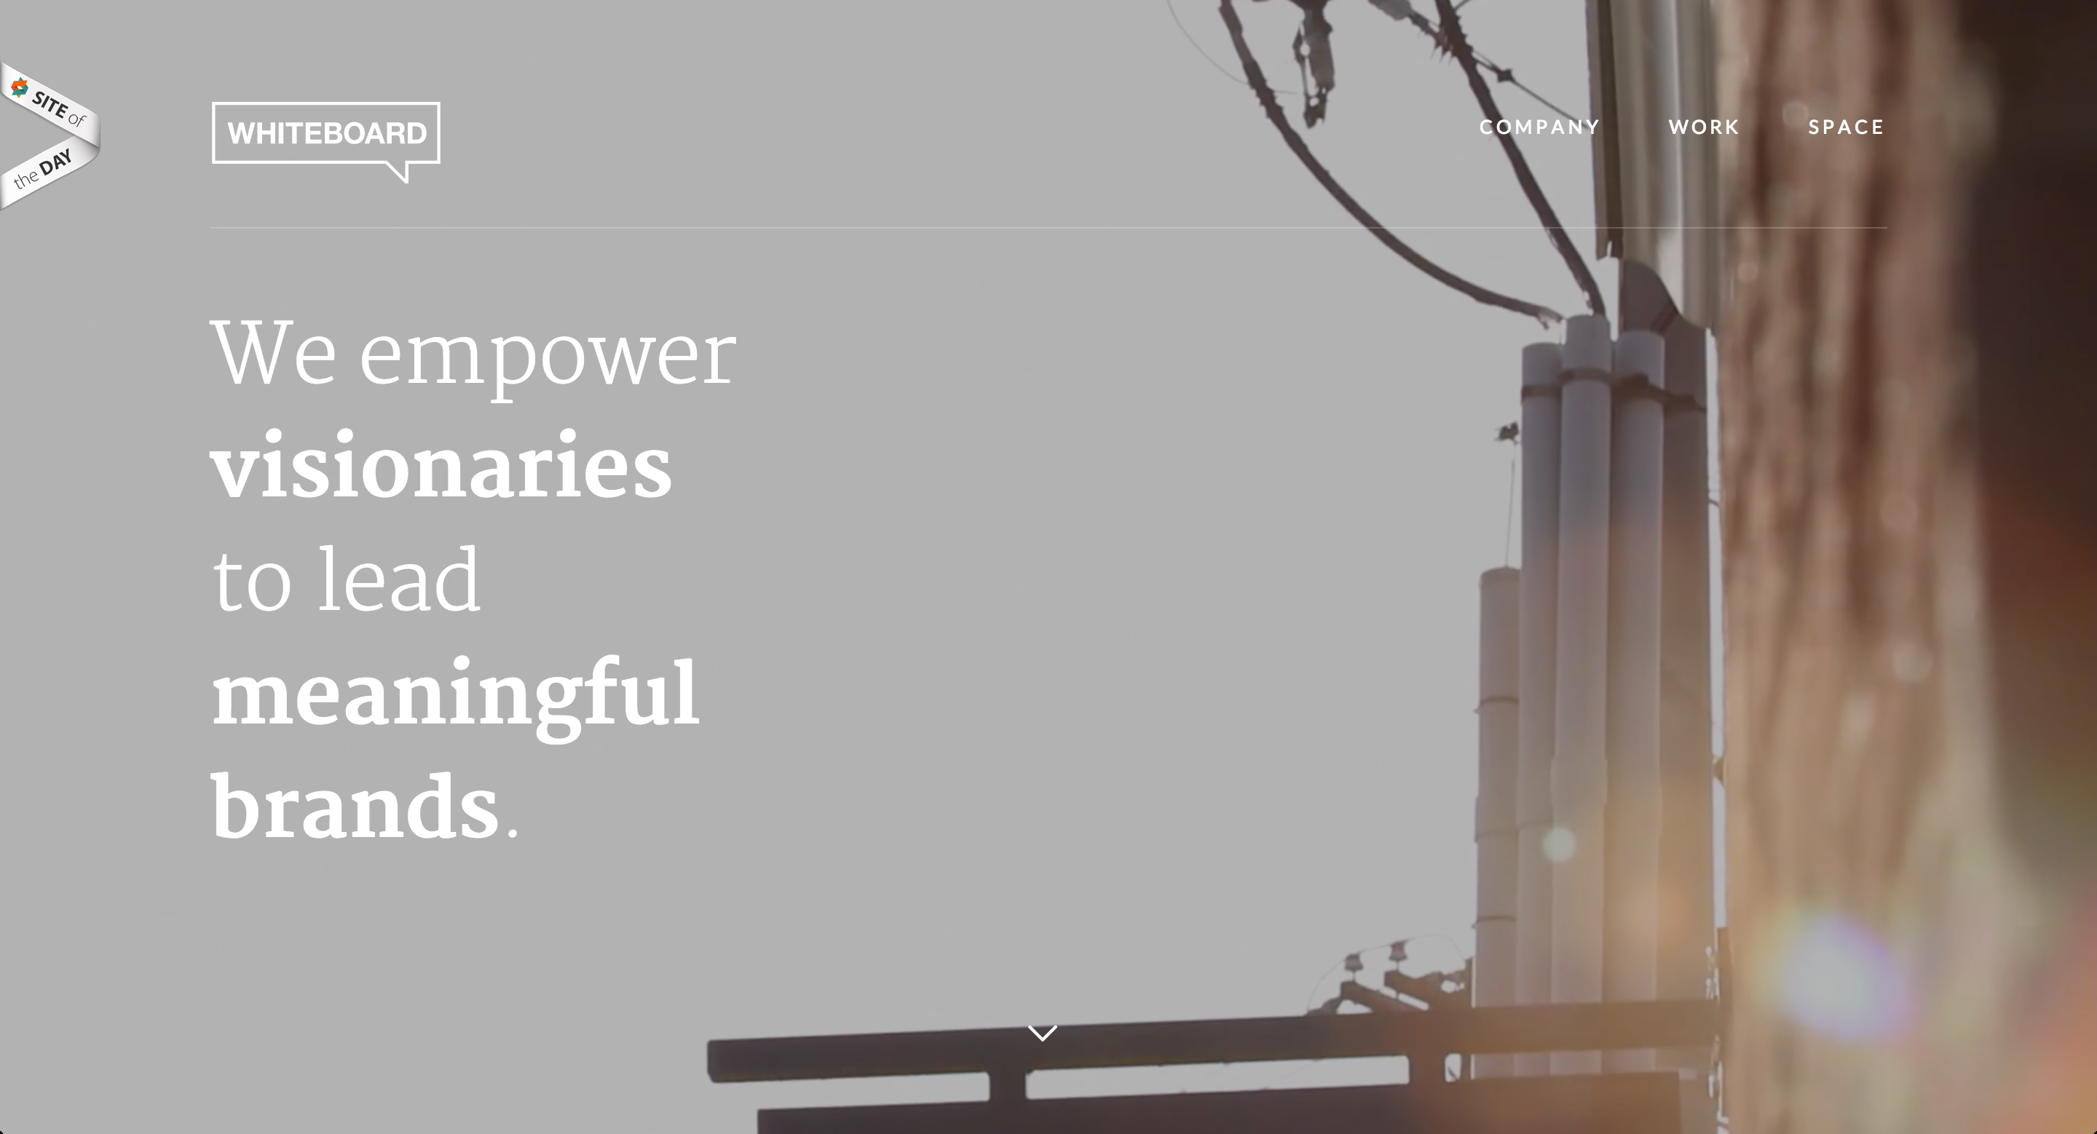
Video Background: Whiteboard.is

Slide 45
Faux Gradient
Trend 2 – Faux Gradient (Fake Gradient)
Basically a very heavy Gaussian Blur applied on top of an image.
Method:
1. Take an image, preferably a landscape or one with a small range of color.
2. Apply 40 – 100px “Gaussian Blur” using Photoshop
You get really interesting gradients that usually look quite nice without worrying about the details.
Notes:
DEMO

Slide 46

Faux Gradient Version of Mavericks Background

Slide 47
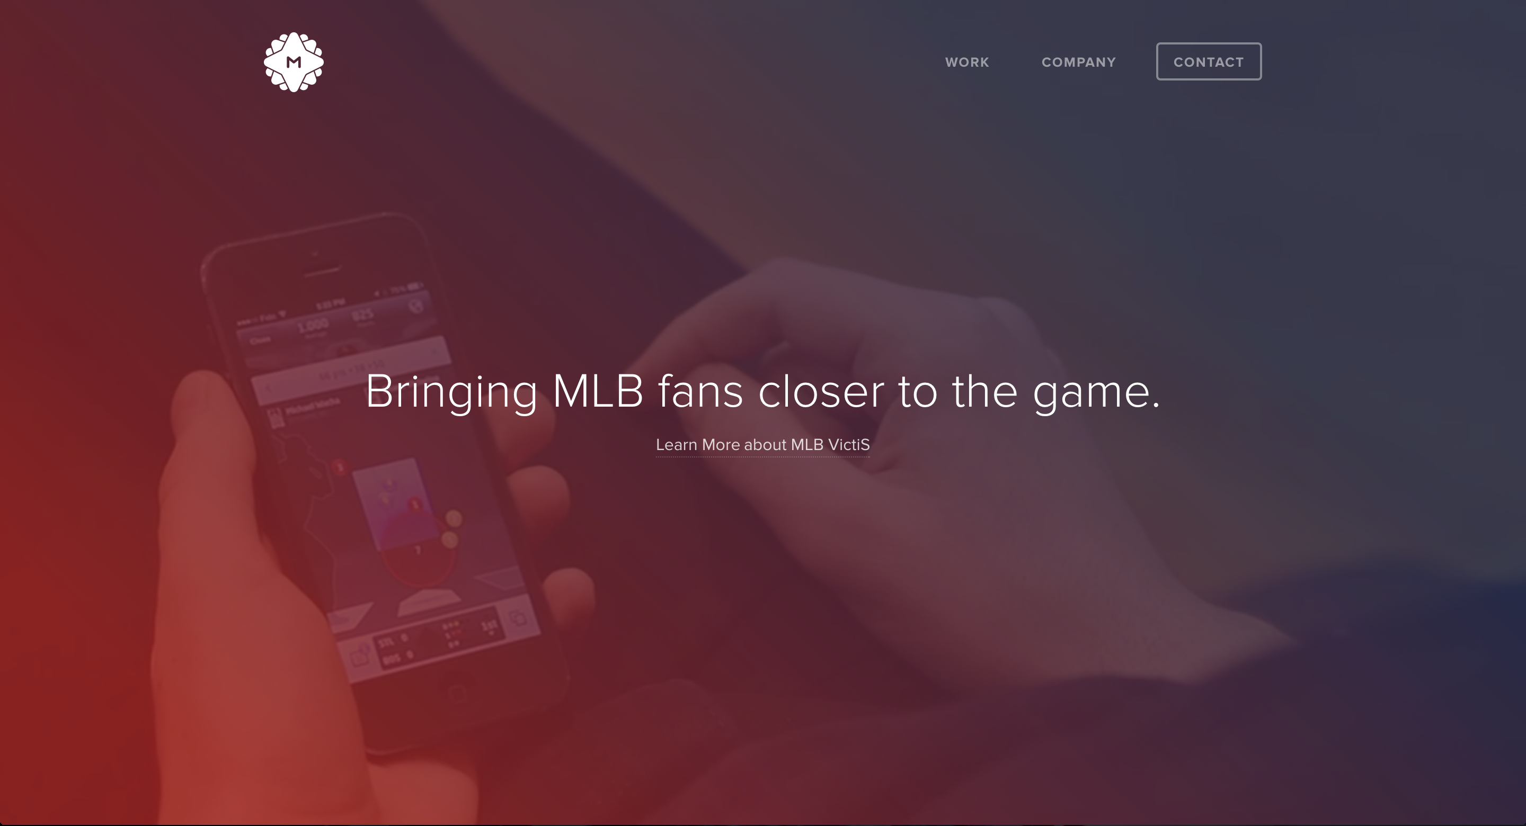
Faux Gradient Overlay on top of a video background

Slide 48
Image Use Case: Background
Trend 3: Polygon patterns
Instead of using a generic 40% opacity black overlay, use polygon pattern overlay
Other patterns are widely used as well – linen, lines, etc.
Basically an opposition to Flat UI’s barrenness.
Notes:
DEMO

Slide 49
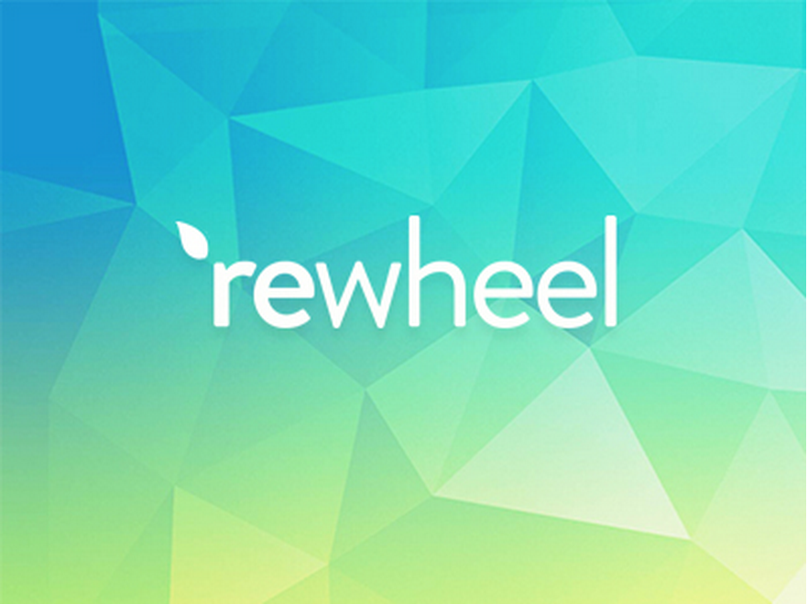
Polygon pattern background

Slide 50
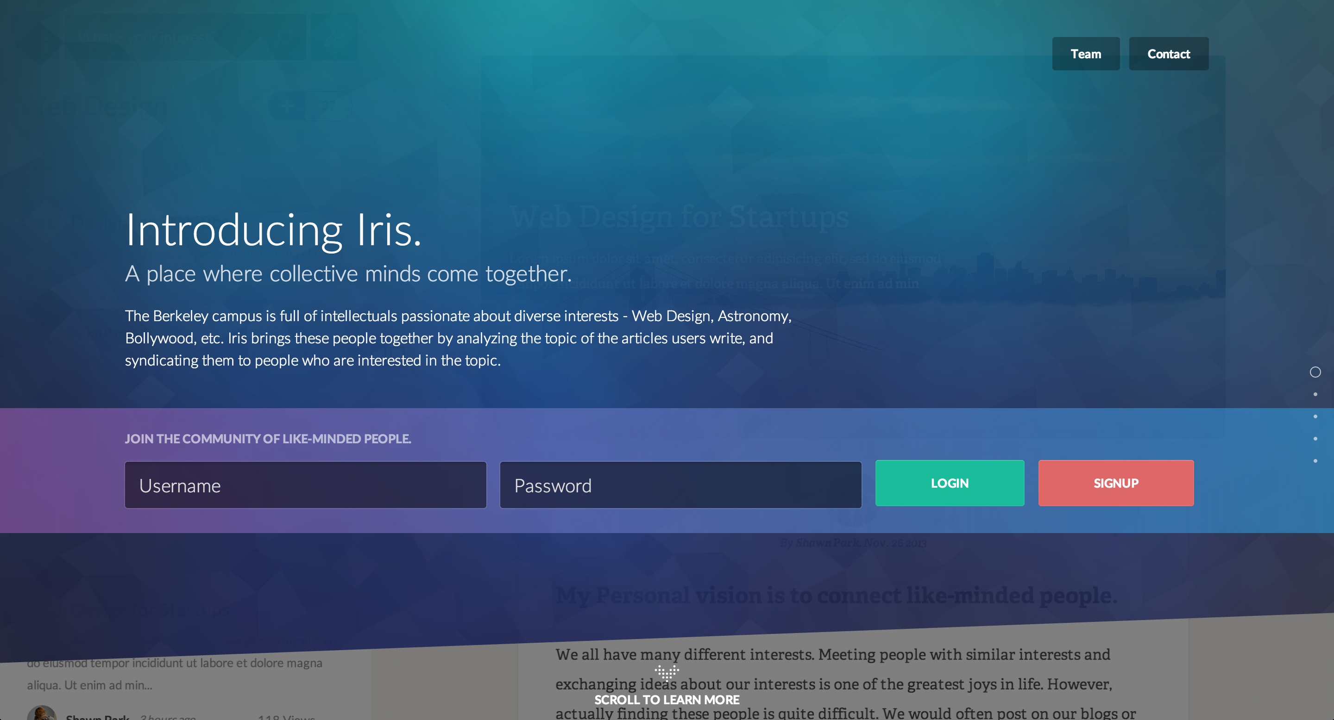
Polygon pattern background

Slide 51
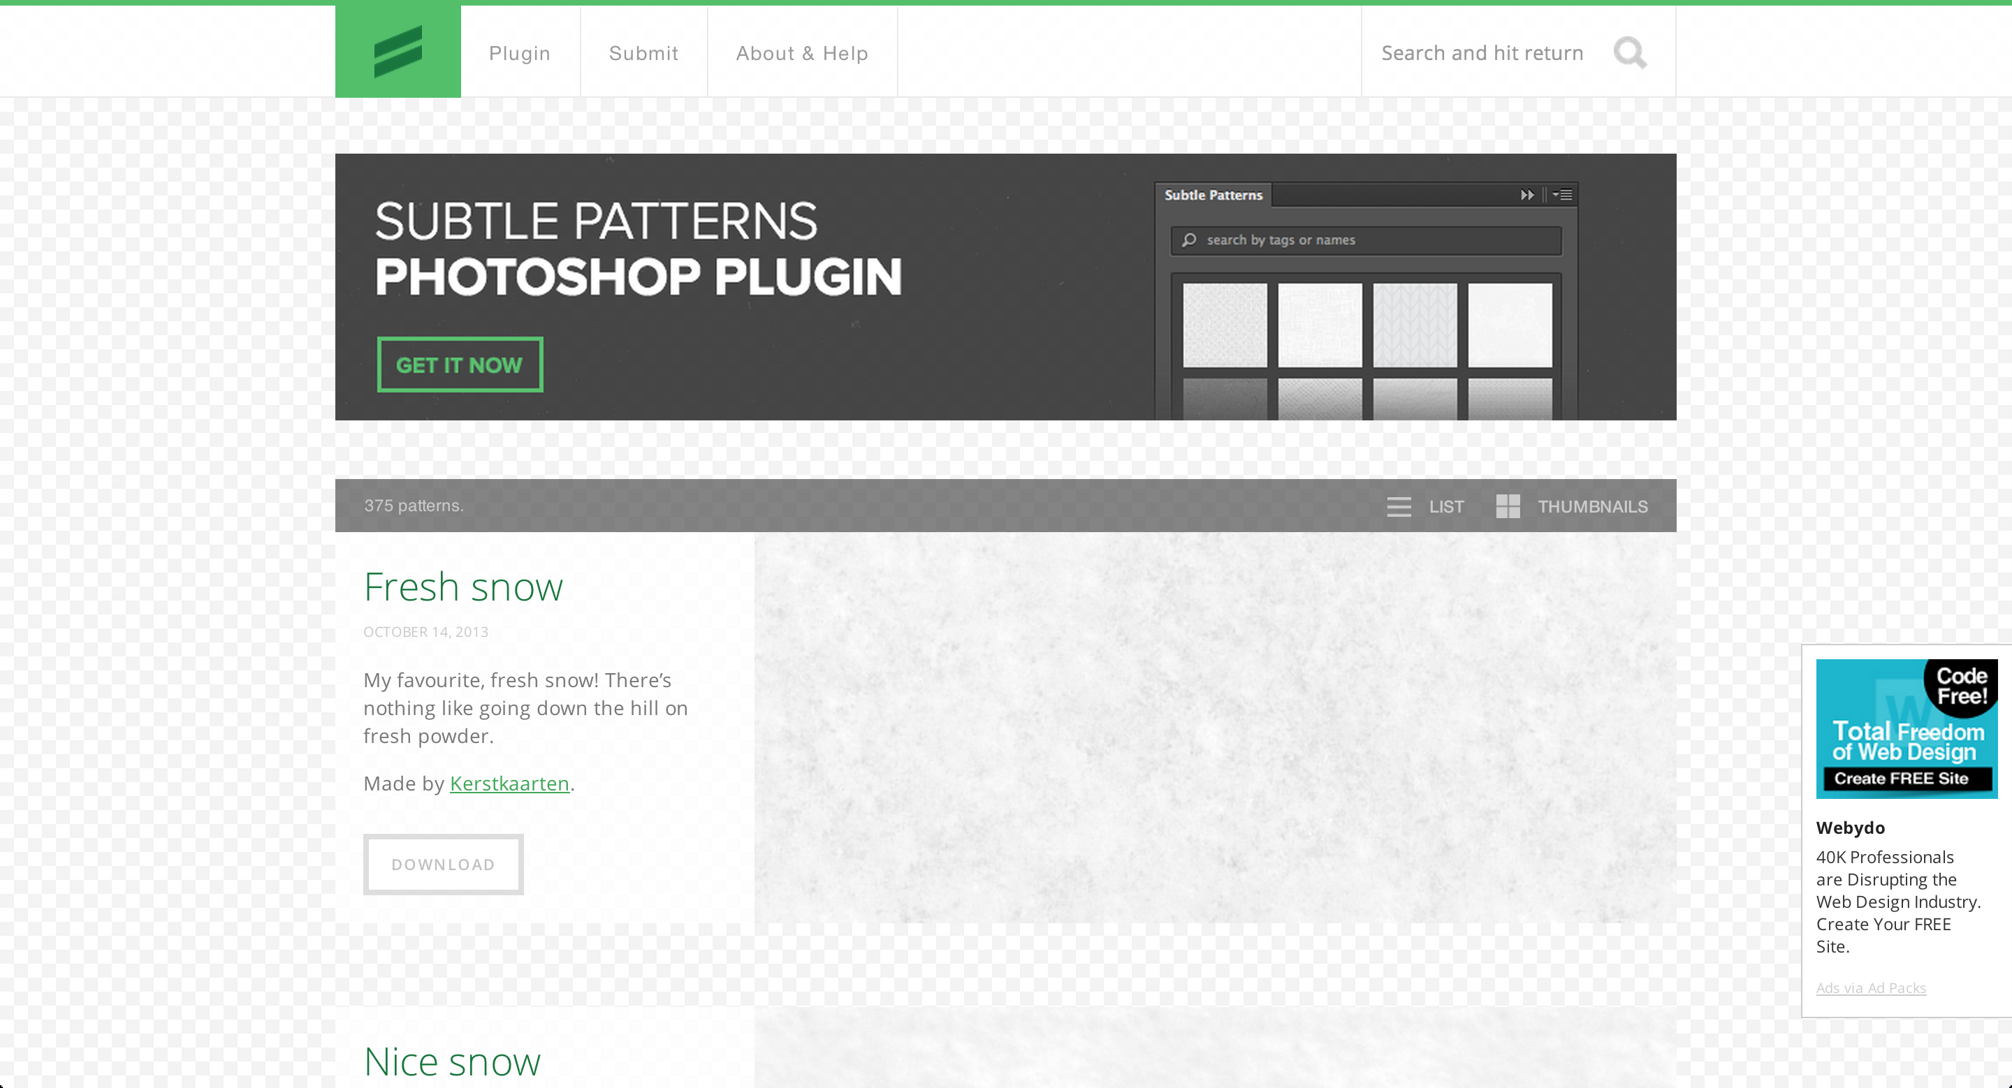
Subtlepatterns

